Slide 1

DSPy for AI: A Revolutionary Framework for Modern LLM Programming
In the rapidly evolving landscape of artificial intelligence, DSPy emerges as a groundbreaking framework that transforms how we build and deploy Large Language Model (LLM) applications. This presentation will take you on a comprehensive journey through DSPy's innovative approach to AI programming.
Author- TANUJKUMAR

Slide 2

From Prompting to Programming
The Traditional Approach (Prompt Engineering)
Today's LLM applications rely heavily on manual prompt crafting. Developers spend countless hours writing, testing, and refining prompts like:
"Answer this question based on the context provided. Be concise, factual, and cite sources. Don't hallucinate. Format your response as JSON..."
This approach is fragile, inconsistent, and doesn't scale. Every model change or task variation requires rewriting prompts from scratch.
The DSPy Revolution
DSPy (Declarative Self-improving Python) shifts from brittle prompt tinkering to structured, compositional programming. Instead of crafting prompts, you define what you want (the task) using modular Python code, and DSPy handles the how.

Slide 3




What Makes DSPy Revolutionary?
Programming Over Prompting
Automated Optimization
Replace fragile string prompts with structured Python code that defines tasks declaratively. Your logic is separate from model specifics, making pipelines maintainable and portable.
DSPy continuously refines prompts and few-shot examples using feedback and metrics. No more endless manual prompt tuning - the system improves itself.
Composable Architecture
Proven Performance
Build complex AI systems using modular building blocks like Signatures, Modules, and Optimizers. Each component is reusable and testable.
Research shows DSPy pipelines outperform standard few-shot prompting by 25-65% improvements, even on smaller open-source models.

Slide 4




The Four Pillars of DSPy
Signatures
Modules
Define the "what" - inputs and outputs like a function signature. Think of them as contracts that specify what goes in and what comes out.
Define the "how" - different reasoning strategies like Predict, ChainOfThought, ReAct, or ProgramOfThought that govern LLM interaction.
Optimizers
Pipelines
The "improvement engine" - engines like BootstrapFewShot and GEPA that refine pipelines using evaluation metrics automatically.
The "complete system" - composable workflows that connect multiple steps into full applications, all optimizable end-to-end.

Slide 5
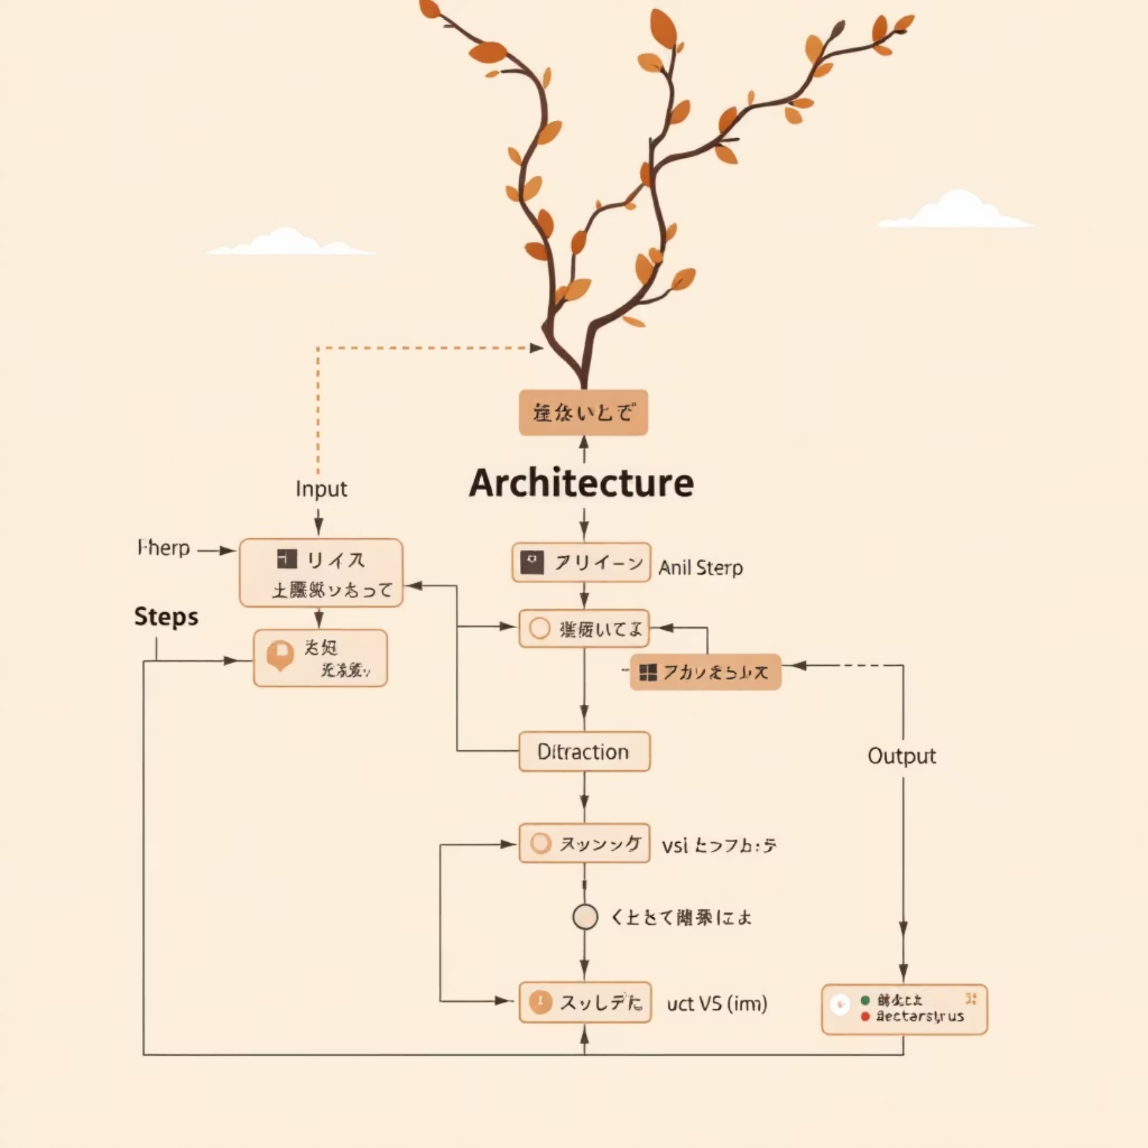
Signatures: Your AI Contract
Think Function Signatures for AI
In traditional programming, we write function signatures to define inputs and outputs. DSPy brings this same clarity to AI:
def add(a: int, b: int) -> int: return a + b
DSPy signatures work similarly but for AI tasks:
class QnASignature(dspy.Signature): question = dspy.InputField() context = dspy.InputField() answer = dspy.OutputField()
This creates a clear contract: given a question and context, produce an answer. No manual prompt crafting required!
Benefits of Signatures
Clarity: Makes AI systems readable and organized
Consistency: Every module follows the same contract
Reusability: Same signature works across different modules
Optimization: DSPy optimizers use signatures to improve pipelines

Slide 6
Core Modules: Your AI Building Blocks
dspy.Predict
dspy.ChainOfThought
The simplest module for direct input-to-output mapping. Perfect for classification, simple Q&A, and summarization tasks.
Encourages step-by-step reasoning before final answers. Ideal for math, logic, and complex reasoning tasks that benefit from "showing work."
predictor = dspy.Predict(QnASignature)
reasoner = dspy.ChainOfThought(MathSignature)
dspy.ReAct
dspy.ProgramOfThought
Combines reasoning with action - lets models call external tools, APIs, or databases. Essential for building intelligent agents.
Generates executable code to solve problems, then runs it safely. Perfect for math, data processing, and structured reasoning.
agent = dspy.ReAct(AgentSignature, tools=tools)
coder = dspy.ProgramOfThought(CodeSignature)

Slide 7

Real-World Example: Customer Support Bot
The Problem
A telecommunications company needs an AI assistant that can handle customer queries using their internal knowledge base. Traditional approaches require extensive prompt engineering for every query type.
The DSPy Solution
class SupportSignature(dspy.Signature): query = dspy.InputField() context = dspy.InputField() response = dspy.OutputField()class SupportBot(dspy.Program): def __init__(self, retriever): self.retriever = retriever self.responder = dspy.ChainOfThought(SupportSignature) def forward(self, query): docs = self.retriever.search(query, k=3) context = "\n".join(docs) return self.responder(query=query, context=context)
Key Benefits
No manual prompt writing
Reusable across query types
Automatically optimizable
Maintainable and testable

Slide 8

The Power of Optimizers
Eliminating Manual Prompt Engineering
Optimizers are DSPy's secret weapon - they automatically improve your AI pipelines without manual intervention. Instead of spending weeks crafting perfect prompts, you provide examples and metrics, and DSPy handles the optimization.
01
02
BootstrapFewShot
LabeledFewShot
Learns better prompts from small datasets of input-output pairs. Automatically builds examples so you don't handcraft them.
Uses explicit labeled data for controlled optimization. Perfect when you have high-quality training examples.
03
GEPA
Advanced gradient-based optimization that iteratively improves instructions using feedback signals like accuracy or F1-score.

Slide 9




Production-Ready Applications
Financial Services
Healthcare
E-commerce
Legal Tech
Banks use DSPy for automated report analysis, fraud detection, and compliance checking. Multi-chain reasoning ensures accuracy in high-stakes decisions.
Medical institutions deploy DSPy for diagnostic support, research automation, and patient query handling with built-in safety constraints.
Online retailers leverage DSPy for personalized recommendations, inventory management, and customer service automation at scale.
Law firms use DSPy for contract analysis, case research, and document review with programmatic validation ensuring compliance.

Slide 10


Getting Started: Your Learning Journey
Recommended Learning Path
Key Learning Resources
Foundation Setup
Official DSPy Documentation: Comprehensive tutorials and API reference
DeepLearning.AI Course: "DSPy: Build and Optimize Agentic Apps" (50-minute free course)
Install DSPy, configure your LLM backend (OpenAI, Anthropic, or local models), and run your first simple signature.
Stanford NLP GitHub: Example projects and community contributions
Research Papers: Deep dive into the theoretical foundations
Core Concepts
Master Signatures and basic modules like Predict and ChainOfThought through hands-on tutorials.
Advanced Modules
Explore ReAct for agents, ProgramOfThought for code generation, and multi-chain reasoning patterns.
Optimization
Learn to use optimizers like BootstrapFewShot to automatically improve your pipelines.
Production Deployment
Build complete applications with validation, monitoring, and scaling considerations.
Start Simple: Begin with a basic Q&A system, then gradually add complexity as you master each concept. The key is hands-on practice with real datasets.
DSPy represents the future of LLM programming - structured, optimizable, and production-ready. By mastering these concepts, you'll be equipped to build the next generation of AI applications that are reliable, scalable, and truly intelligent.

